Slide 1

Case study 3
Salma, Amanda, Ariel, Delaney, Mesay, Katrina

Slide 2
Background (Mesay)
GW is a 81 year old Hispanic male who has worked hard as a dairy farmer in the south and, even though his son does most of the work now, he still works hard for his age. The long hours and hard work have kept him active and, unlike his four siblings, he has never had a weight problem. In fact, his weight has been on the low side of normal all of his life, weighing between 135# and 140# consistently. He is 5’ 6” tall. He has an Hx of hypothyroidism and arrhythmias. Recently, he started having diarrhea and noticed blood in his stool on occasion. He did not have a change in the way he felt other than being tired, but he thought that came with age. Being a stubborn man and not liking doctors, he refused to go see his physician. When the diarrhea and bleeding persisted and got worse, his wife stepped in and made the appointment for him.
His family practitioner sent him to a gastroenterologist for a colonoscopy. A mass was found in the sigmoid colon and a biopsy was taken. The mass was found to be malignant. GW was sent to a surgeon and surgery was planned immediately. His standing weight at admission was 132#.

Slide 3
Describe the action and any nutritional side effects of the following drugs: (Ariel)
Action
Nutritional side effects
(Digoxin) This type of drug is under the classification of cardiac glycosides, that inhibits activity of the enzyme ATPase which controls the movement of sodium, potassium, calcium into the heart
Synthroid (Levothyroxine) This medication treats hypothyroidism along with goiters and thyroid cancer. Synthroid restores thyroid levels by regulating thyroxine the body may be missing.
(Cordarone) Effective by blocking electrical signals that induce irregularity in heart rhythmic
Decreases the absorption of magnesium hydroxide, aluminum hydroxide and charcoal. High fiber foods along with fruit juices should be avoided between a 2 hour interval after medication. Foods containing cottonseed and soy should be avoided or limited due to drug interactives reducing efficacy.
Interaction with the dietary drug calcium carbonate (decreases absorption) along with ferrous sulfate. Tolerable Upper Intake levels exceeding normal amounts have vomiting, diarrhea, loss of appetite etc..
Vomiting, nausea, loss of appetite. Avoid grapefruit and grapefruit juices

Slide 4
Compare GW’s UBW to his IBW (calculate % UBW and % IBW). If his UBW has been slightly lower than his IBW all his life, is that of any major concern? Is the fact that he is now, upon admission to a hospital for colon cancer, a little below his UBW of concern? Explain. (Ariel)
(135-140) (normal circumstances)
132 lb. (admission)
IBW: (106 + (6*6) = 142
IBW%: ( 132/142) * 100 = 93% (Adequate)
% UBW: 132*100/137.5 = 96%
His UBW should not be a major concern related to the patient being between 135-140 # all his life. There is no history in the GW having any weight problems. Upon admission, with his weight being lower than his usual weight, one should pay close attention because he could potentially be losing nutrients related to his diarrhea. He could also be losing weight due to the stress being built from colon cancer. It will be important to monitor any changes in weight, since we want to prevent cachexia. Wasting in patients with cancer is the cause of death of one third of all cancer deaths and even a little weight loss can be predictive of worst outcomes.

Slide 5
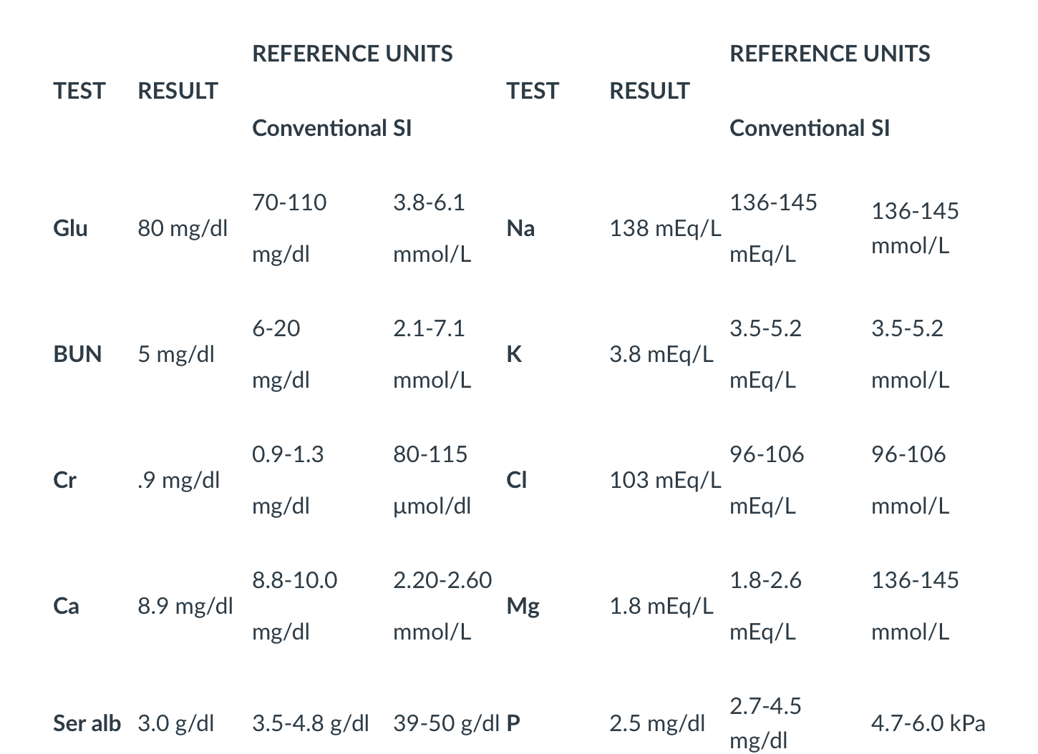
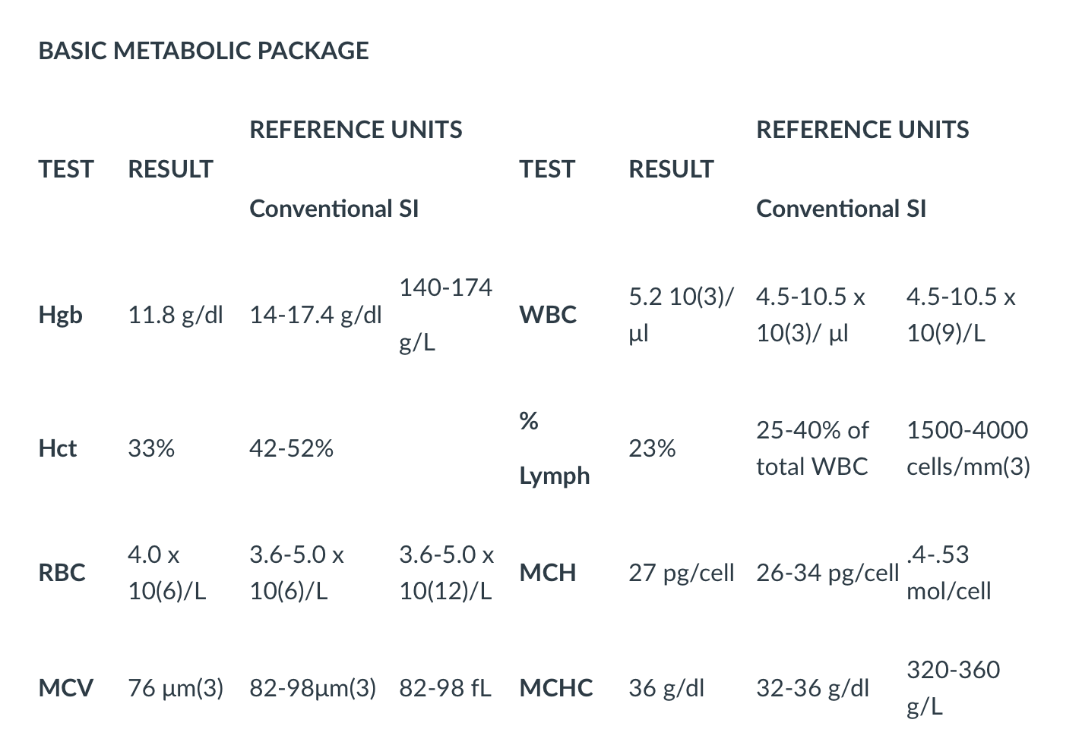
Assessment of laboratory values (Delaney)

Slide 6
Assessment of laboratory values (continued)(Delaney)
Irregularities are serum albumin, BUN, P, Hgb, MCV and % lymph lower than reference units.
Hgb and Hct lower the normal, possibly due to gastrointestinal bleeding through stool
% lymph may indicate possible infection/illness
Low BUN could be due to the patients PO intake, malnutrition or possibly severe liver damage
Lower and low end of potassium and magnesium may be due to malnutrition and chronic diarrhea
Low Hct values could be due to a large number of white blood cells fighting infection, long term illness or anemia
Lastly, low MCV values could mean microcytic anemia caused by either iron deficiency or GI bleeding

Slide 7
GW Intervention by RDN oncologists (Delaney)
Colorectal cancer is especially a cause for concern due to the higher risk of disease related malnutrition for gastrointestinal cancers.
Based on the lab values using the reference units, a degree of malnutrition has been documented.
Losing weight from his usual body weight shows that a proactive response is best to reverse and prevent nutritional deficiencies, post surgery complications and improve metabolic conditions.
A nutrition focused physical examination would see if GW’s is showing physical signs of malnutrition.

Slide 8
Calculate GW’s calorie, protein and fluid needs. Is there anything specific that you might suggest to promote healing and/or prevent infection? (Salma)
Upon admission weight: 132 # = 60 kg
Height: 5’6” = 167.64 cm
Age: 81
Stress Level: 1.6
Energy needs:
Energy needs for cancer patients: 30-35 kcals/kg
30 x 60 = 1800 kcal/day
35x 60 = 2100 kcal/day
Range : 1800 - 2100 kcal/day
Estimated calories using the equations to make sure we are in the correct range:
MSJ: (9.99 x 60) + (6.25 x 167.64) - (4.92 x 81) + 5= 1253.63 x 1.6 = 2006 kcal
HBE: 66 + (13.7 x 60) + (5 x 167.64) - (6.8 x 81) = 1175.4 x 1.6 = 1880 kcal
Range: 1880- 2006 kcal
High energy needs will help him get his immune system stronger to help him heal and maintain body weight.
Protein needs: Due to malnourishment by lab values along with rapid weight loss, as a malnourished hospitalized patient, his protein are 1.2-2.0 g/kg body weight.
Used current weight
Lower end for protein: 1.2 * 57 kg = 68 g protein/day
Upper end for protein: 2.0 * 57 kg = 114 g protein/day
His protein needs are probably closer to a higher end, which would make protein provide 22.8% of his total caloric intake.
Fluid needs:
Range 20 mL/kg - 40 mL/kg
Used current weight
Lower end: 20ml/kg * 57 kg = 1140 ml/day
Upper end: 40 ml/kg * 57 kg = 2280ml/day

Slide 9
Dietitian’s interview (Mesay)
Having a family member or spouse present with the dietitians allows both parties to freely express their own judgements and criticisms they have about meeting the nutritional requirements of the patient.
The dietitian had a difficult time unpacking information and gave her own opinion on her single single matter instead of using active listening and reflecting back to the patient.
These behaviors drive a rift in the relationship with the client and may prevent the patient from fully opening and trusting the RD.

Slide 10

Would a NFPE be helpful? Why/why not? (Mesay)
Absolutely yes, it is beneficial to use a NFPE cancer patients are at risk of malnutrition
Due to GW’s usual body weight decreasing, along with frequent bouts of diarrhea and not gaining the correct caloric needs it would be help for a NFPE.

Slide 11
What tube feeding would you recommend and why? Write the TF prescription? (Salma)
Energy range: 1880- 2010 kcal
Pick Formula: Pivot 1.5
1700 kcal / 1.5 mL/kcal= 1253.3 mL
Rate = 1253.3 mL/24 hr =52.22 mL/hr = 55 mL/hr Check: 55mL/hr x 24 hr = 1320 mL TV 55 mL/hr x 24 hr x 1.5 kcal/ mL = 1980 kcal
Grams of protein? 1.320 L x 93.8 g/L = 123.8 = 124 g
mL water? 1.320 L x 759 mL/L = 1001.88 = 1002 mL 2280-1002 = 1278 mL/ 6 hr = 213 mL/ every 4 hours
TF of Pivot 1.5 at a goal rate @ 55 mL/hr x 24 hr with 213mL flush of water every 4 hours (to provided 1340 mL TV, 1980kcal, 124 g of protein, and 2280 mL of water)
Although Pivot went over protein range it would give GW the nutritional support he needs to help fight off potential infections and provide him with his energy needs.

Slide 12
Research the following drugs and describe their function, side effects, and nutritional implications (Katrina)
Drug | Function | Side Effects | Nutritional Implications
Megace | Used to help muscle wasting, significant weight loss (>10%). Megace inhibits specific hormones cancer use as fuel sources to aid in the reduction of cancer cell growth. It interacts with other hormones as well. | Weight gain, edema, spotting or changes in menstrual flow. Also insomnia and impotence | Enhances appetite and improves body weight
Lomotil | Antimotility agent to treat diarrhea. A combination of two drugs: atropine and diphenoxylate. | Drowsiness, dizziness, headache, tiredness, blurred vision, dry mouth | Avoid drinking alcohol increase sedative effect.

Slide 13
Research the following drugs and describe their function, side effects, and nutritional implications (continued)
Donnatal Tablets | A combination of anticholinergic/antispasmodic and barbiturate sedative used to treat abdominal pain, bloating and cramps in patients with irritable bowel syndrome. | Weakness, dry eyes, dry mouth and vomiting and difficulty urinating | Drinking alcohol could increase drowsiness
Kaopectate | Agent to treat diarrhea, heartburn, nausea and upset stomach . As an adsorbent, to decreases the number of bowel movements and makes stools less watery | Changes in behavior with nausea or vomiting, hearing loss, worsened stomach symptoms, anxiety and dizziness | Might increase oral intake due to diarrhea or stomach pain. Drinking alcohol not recommended due to increase dizziness and drowsiness
Advil | Nonsteroidal anti-inflammatory drug frequently used for pain and fever. Blocks receptors and neurotransmitters for signaling pain | Could raise blood pressure, upset stomach, nausea, vomiting, headache, diarrhea, constipation | Decreases how much prostaglandins one makes. Stomach damage such as bleeding and ulcers are possible side effects

Slide 14
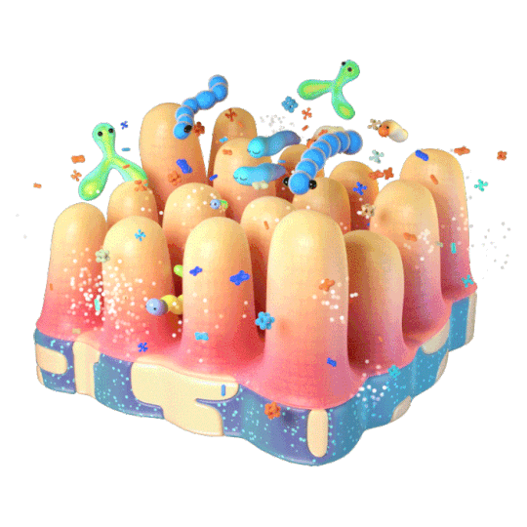
What are probiotics and how could they help with diarrhea? Can you find any probiotic brands that have been researched and shown to be effective? What criteria do you want to look for when choosing a probiotic? (Amanda)
Probiotics help with protecting your intestines against infection. When your system is changed by antibiotics or overwhelmed by unhealthy bacteria or viruses, you can get diarrhea. Probiotics can help with diarrhea by restoring the balance of bacteria in your gut.
Research that shows that the bacteria strains most likely to help are, Lactobacillus reuteri, Lactobacillus rhamnosus, and the probiotic yeast Saccharomyces boulardii, although other strains might be useful. There are many different probiotics to choose from. A couple that we found were Florastor and Cluturrelle.
When choosing a probiotic you should look at the brand of it, the CFU, which is the amount of living organisms and the higher number the better. Look at the expiration date, storage instructions and the type of probiotics that are in it. You want to look for the genus Lactobacillus, Bifidobacterium or Saccharomyces boulardii because they are the most researched.
There is still lack of research for probiotics and which are 100% accurate.

Slide 15
If GW continues to eat poorly at home, how would you change his TF? What if he is able to meet 50% of his needs by PO intake? (Amanda)
The TF prescription is written to supplement all of GW’s needs so I think it is fair to continue his TF whether nocturnal or bolus feedings to give him freedom. If he wants to eat something PO, then we should encourage that but continue the TF. If he can eat 50% of his calories PO, then we can change the TF prescription to meet 50% of his needs and open the possibility of bolus or nocturnal feeding.

Slide 16
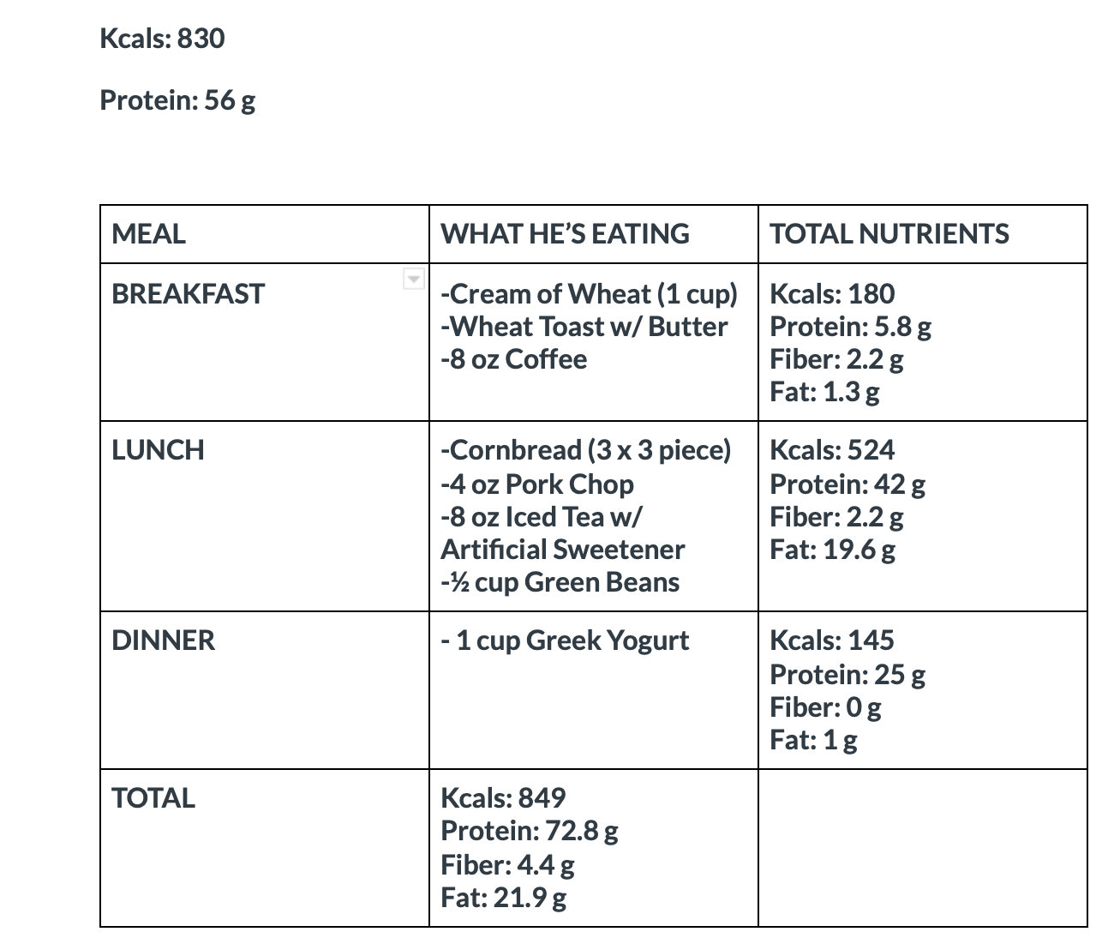
Prepare a menu for GW assuming he can meet 50% of his needs orally. (Katrina)

Slide 17
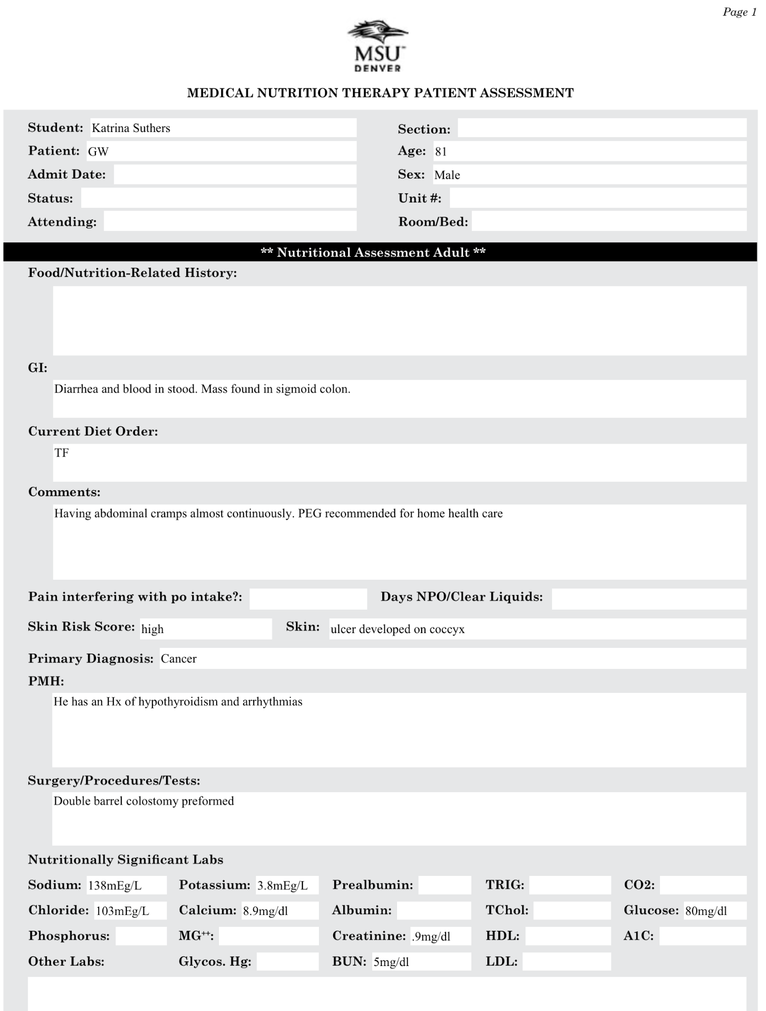
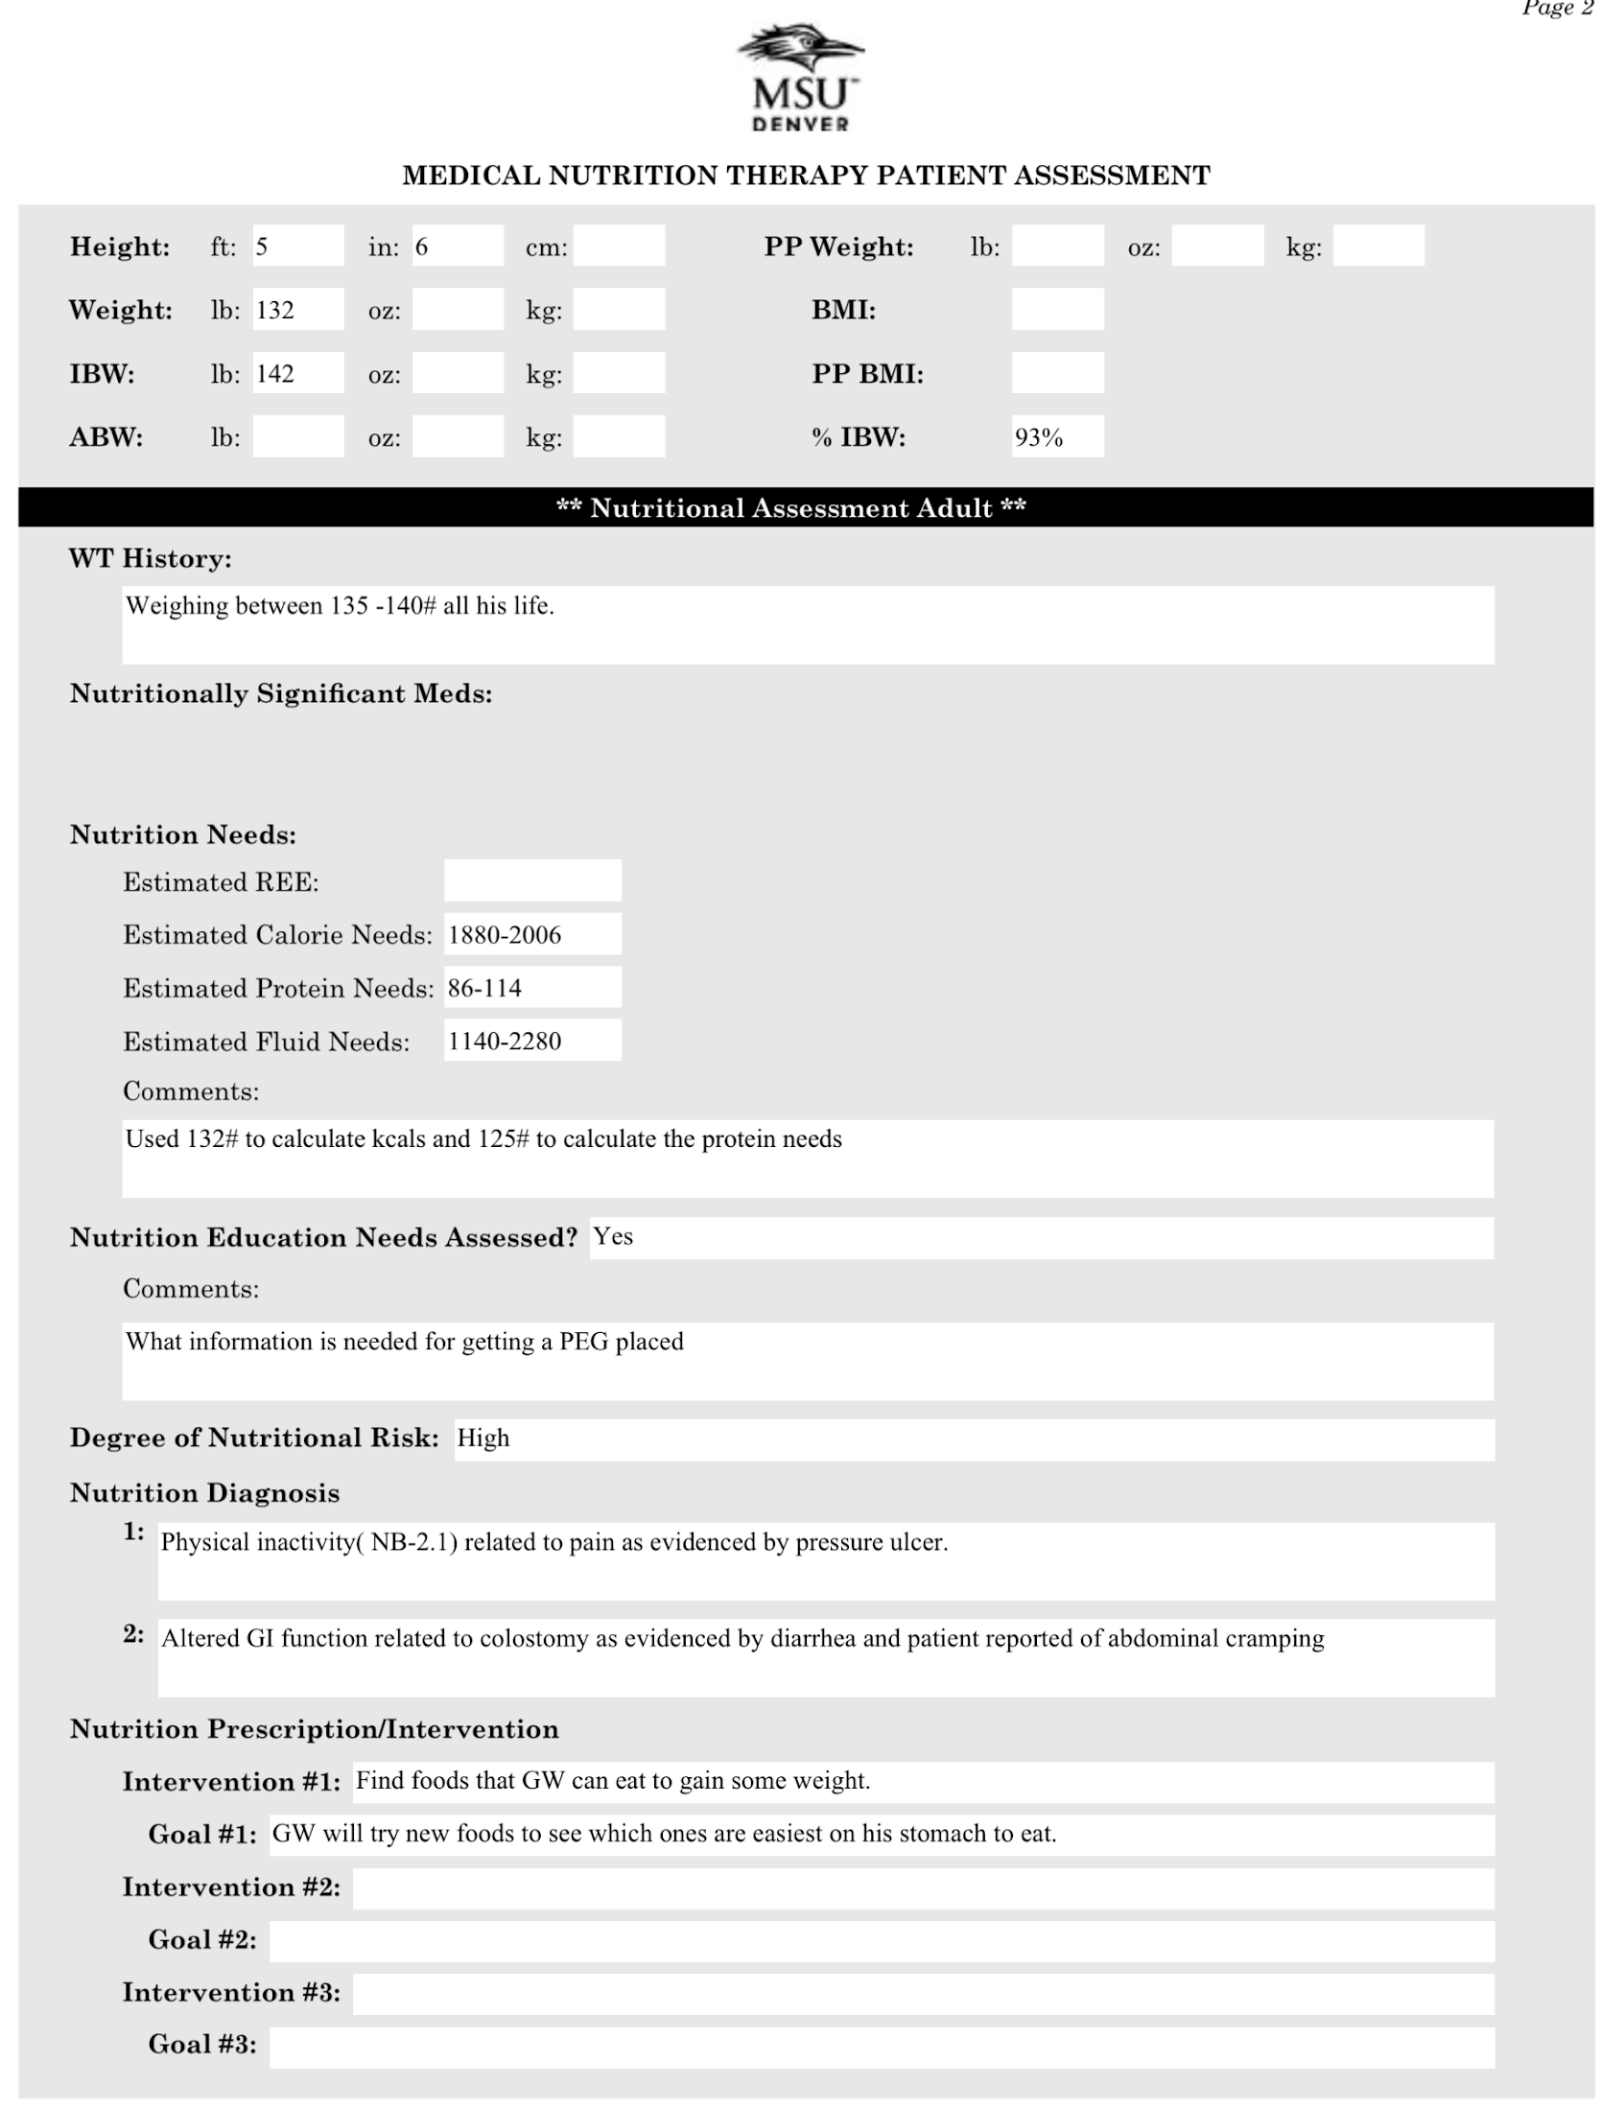
Physical inactivity( NB-2.1) related to pain as evidenced by pressure ulcer.
Altered GI function related to colostomy as evidenced by diarrhea and patient reported of abdominal cramping

Slide 18
Questions?

